Slide 1
October Research Update

Slide 2
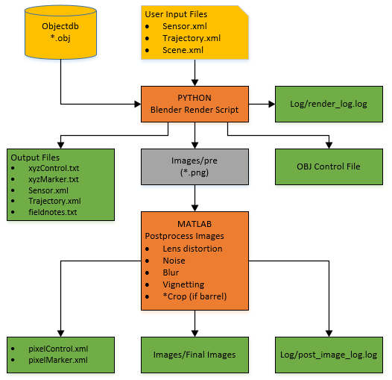
V1.0 of Workflow
Automated Rendering
Formatted Output Files
Basic Object Database
No Lighting Enabled
(shadeless)

Slide 3
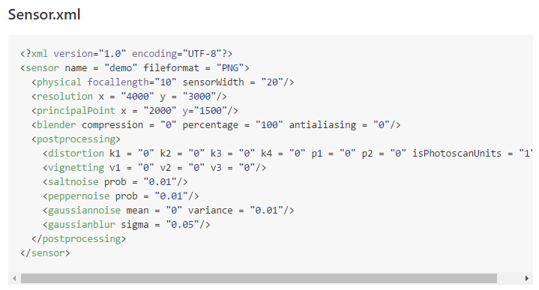
Input: Sensor.xml

Slide 4
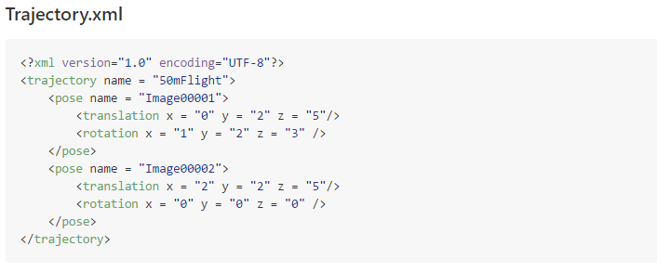
Input: Trajectory.xml

Slide 5
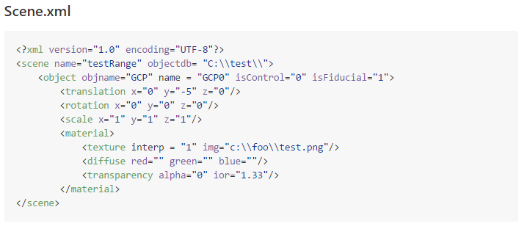
Input: Scene.xml

Slide 6
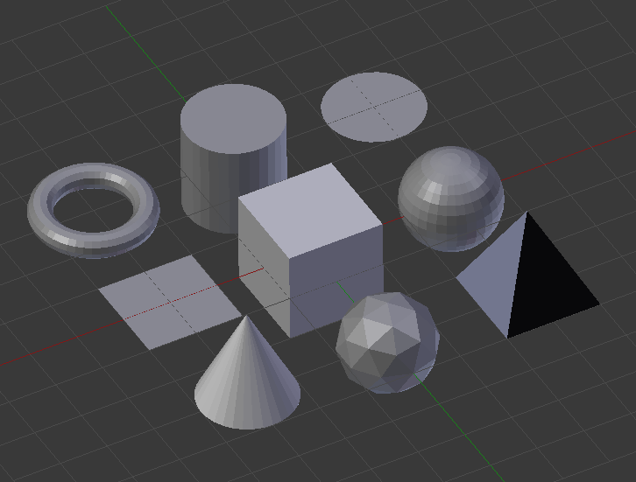
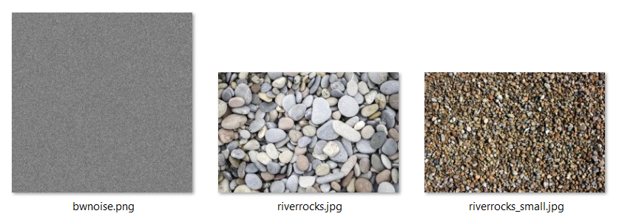
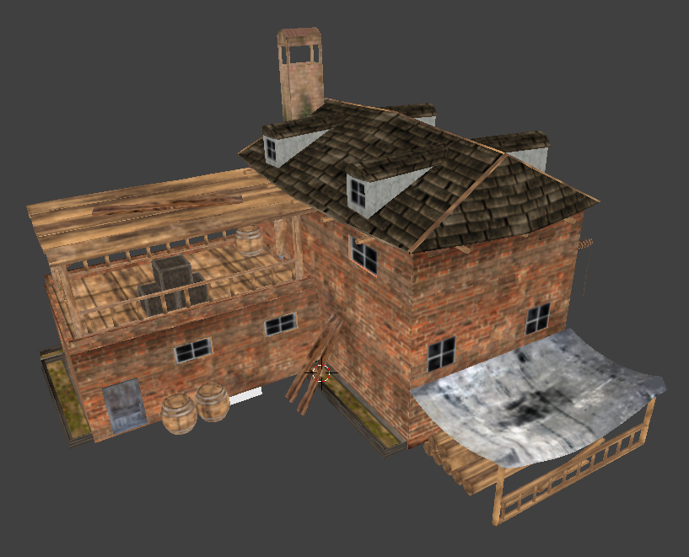
Input: Object/Texture Database
9 Primitive shapes
Various OBJ files with textures
House
Power Lines
Car
Hilly Topography
Ideas?

Slide 7
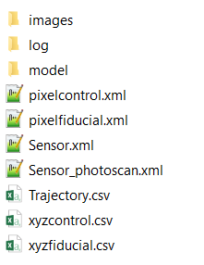
Output:
xyz of each control point (xyzControl.csv)
xyz of each fiducial point (xyzFiducial.csv)
xyz roll pitch yaw of each camera (Trajectory.csv)
Camera Intrinsic parameters (Sensor.xml)
Pixel coordinates of each marker in each image
Pixel coordinates of each fiducial in each image
Model folder with obj of the scene
Log folder with debugging info
Images folder with rendered imagery

Slide 8

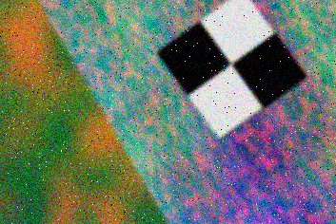
Image Postprocessing
Add Image Distortion
k1,k2,k3,k4,p1,p2 Brown Coefficients
Vignetting
ΔI = v1 + v2 * r + v3 * r^3 where v coefficients are normalized by maximum r
Salt and pepper noise
Defined by a probability of each and random number function
Gaussian Noise
Defined by a mean and variance
Gaussian Blur
Defined by sigma
Raw Render
Postprocessed

Slide 9
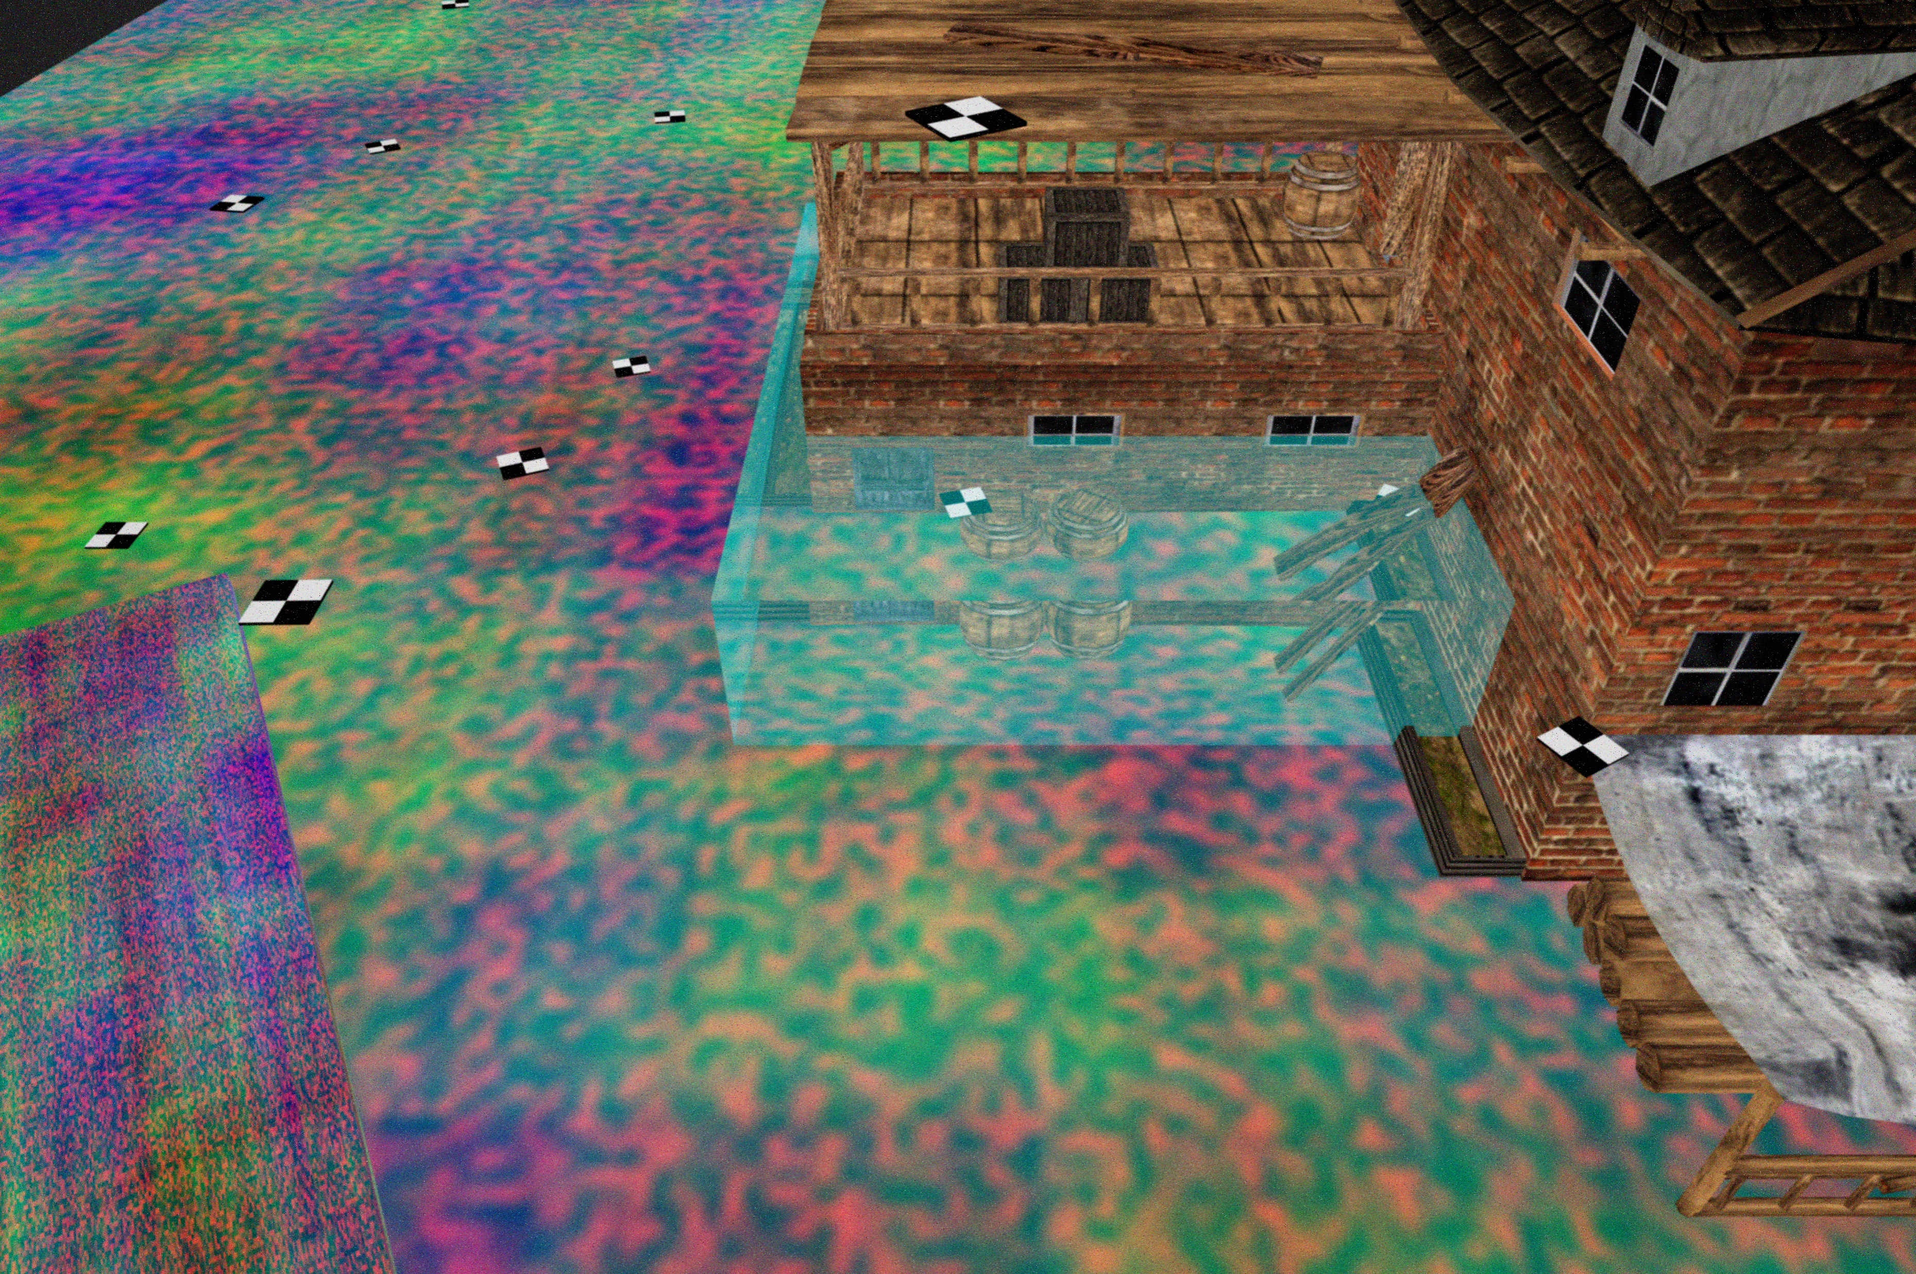
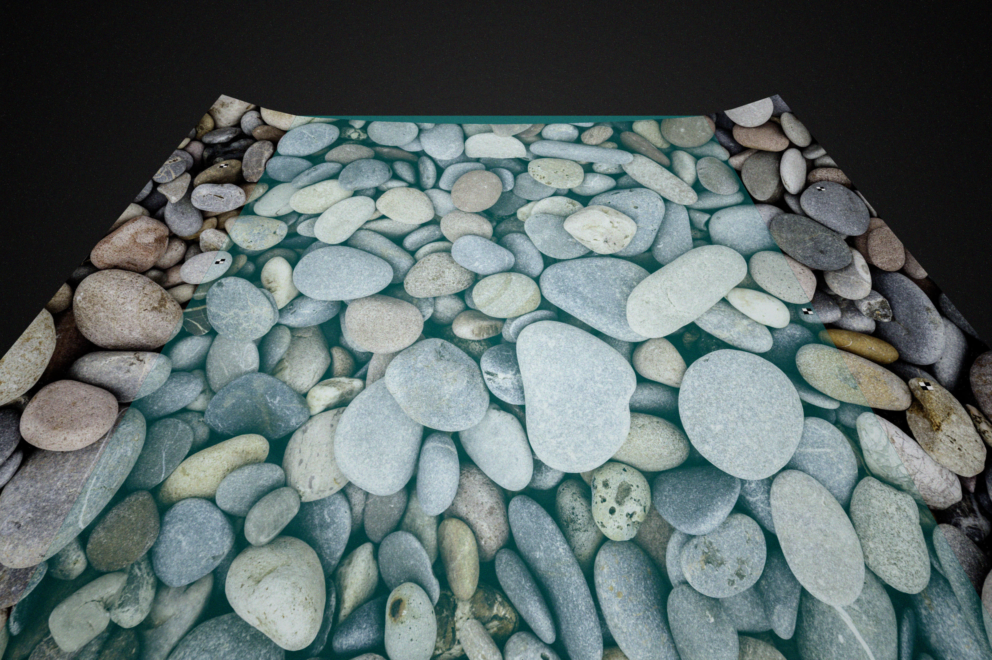
Two Example Scenes
“river”
House + Noise + Water
25 Nadir Images (20MP)
“foo”
House + Noise + Water
63 Nadir Images (20MP)

Slide 10
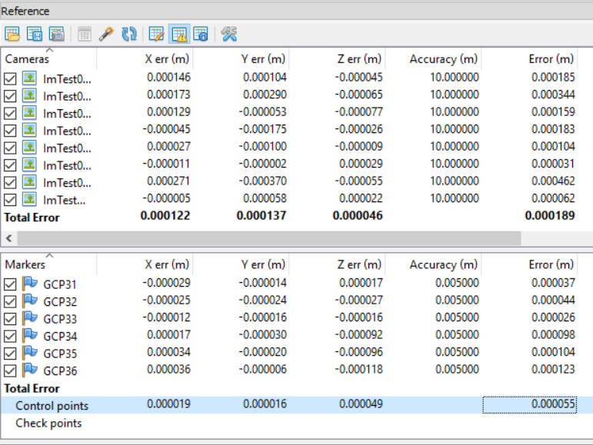
Photoscan Quick Analysis
Error <1mm when given camera extrinsics, intrinsics, GCP positions, and sub-pixel Coordinates of GCPs

Slide 11
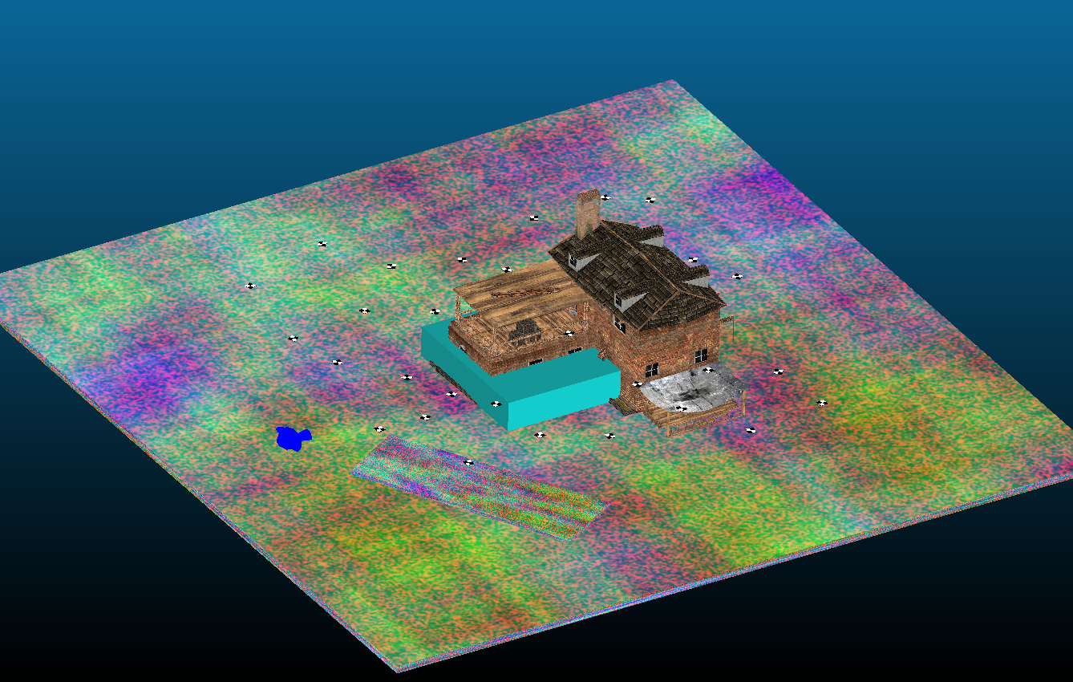
Model of Scene

Slide 12
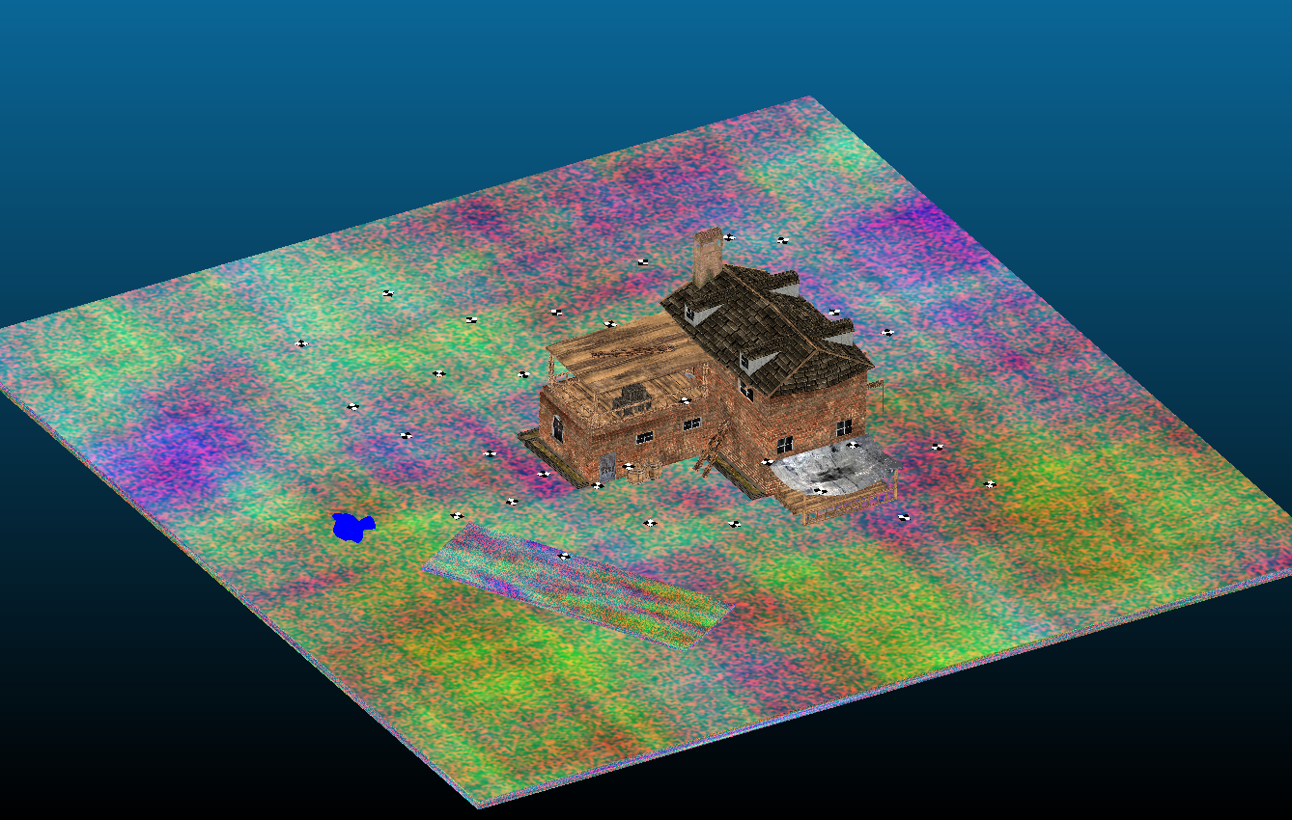
Water Removed

Slide 13
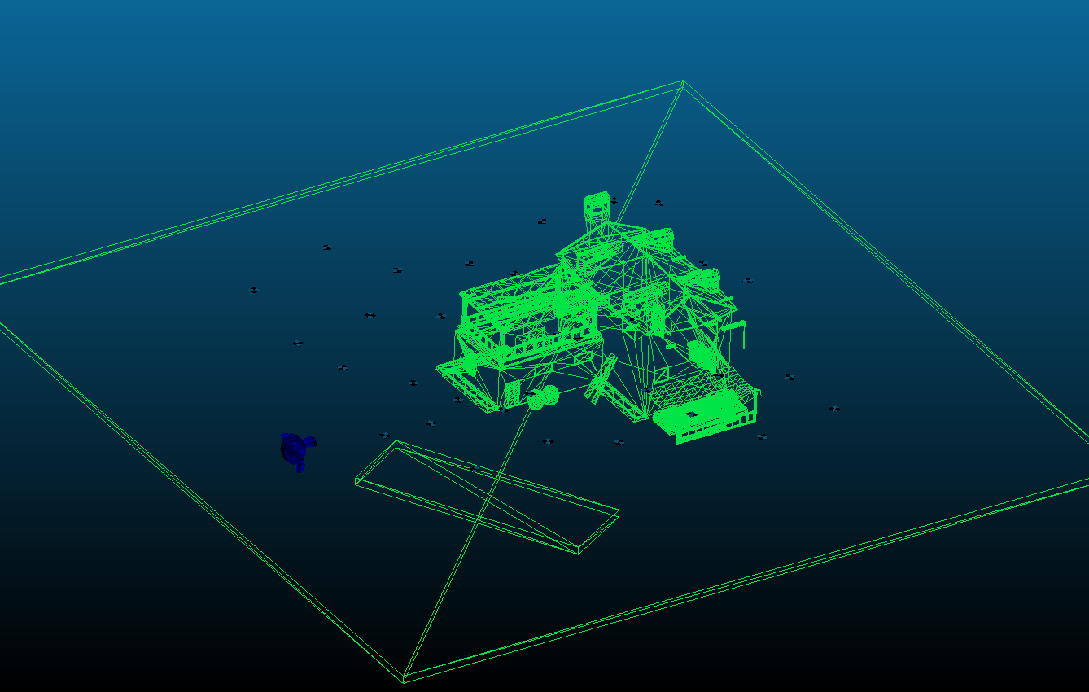
Faces of Model Exposed

Slide 14
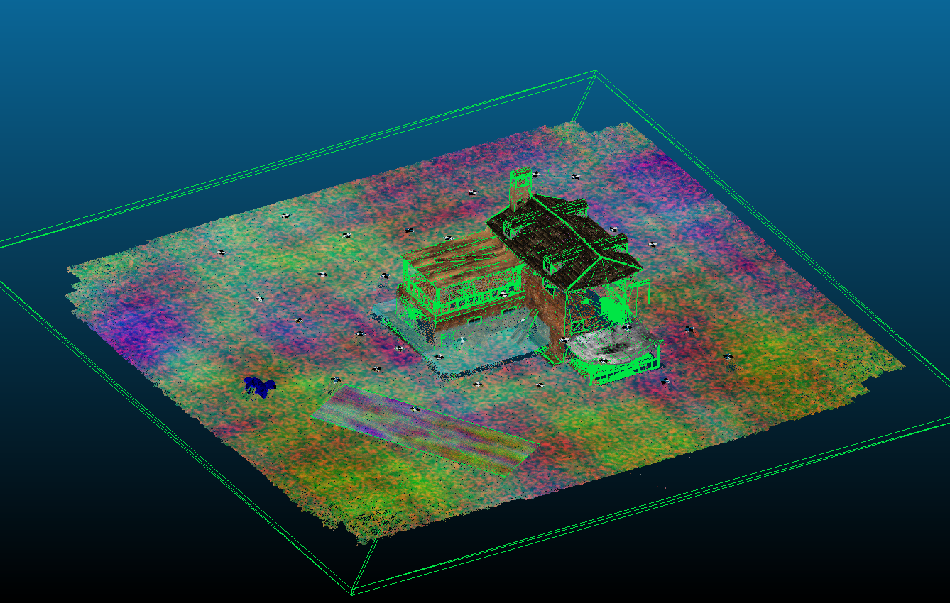
RGB Pointcloud Overlaid

Slide 15
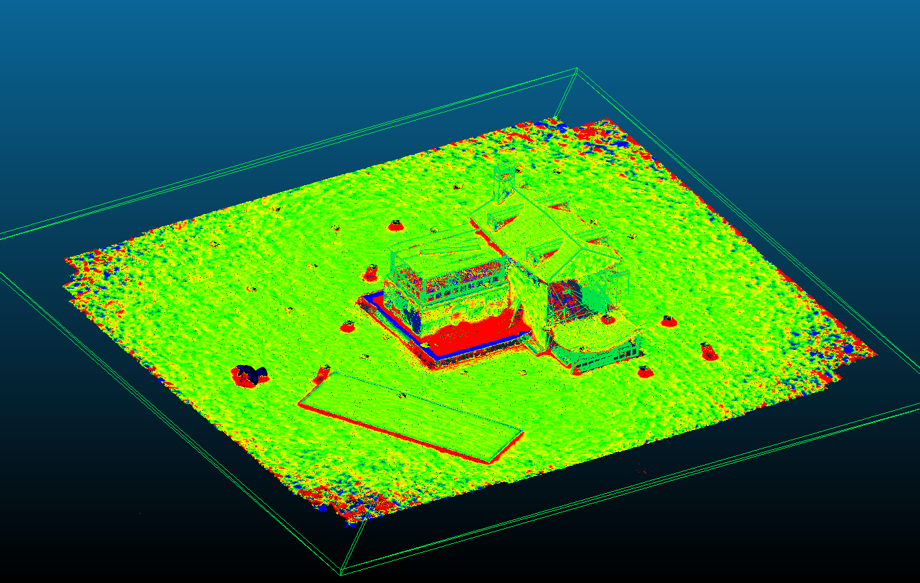
Model to Pointcloud Calculation
-10cm to 10cm

Slide 16
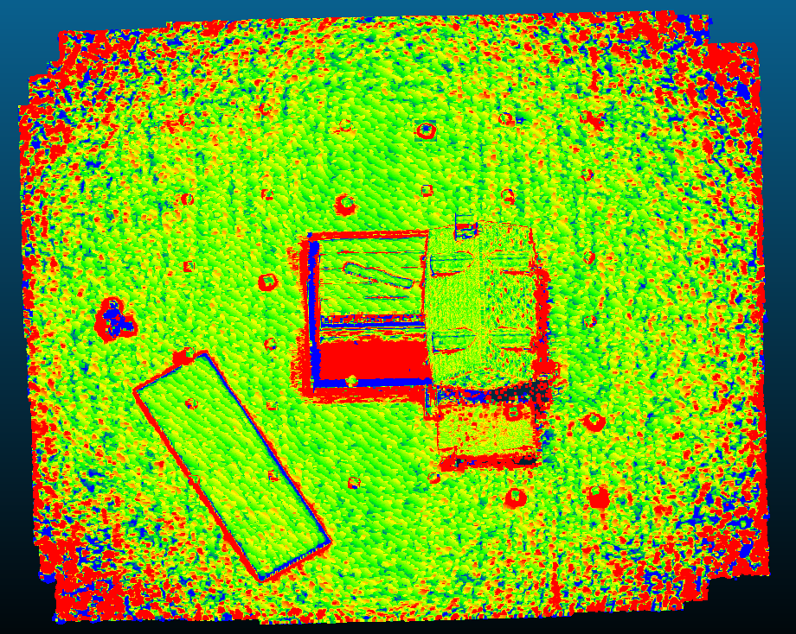
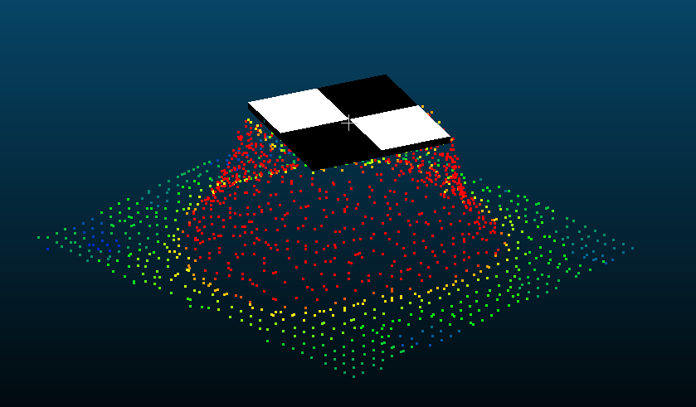
Initial ‘foo’ observations
“submerged” points under the water cube are too high
GCPs experienced mixed pixel effect (dense reconstruction)
~+ 5cm noise on the flat surface… despite “sub mm” GCP accuracy
-5cm to 5cm
1m x 1m GCP

Slide 17

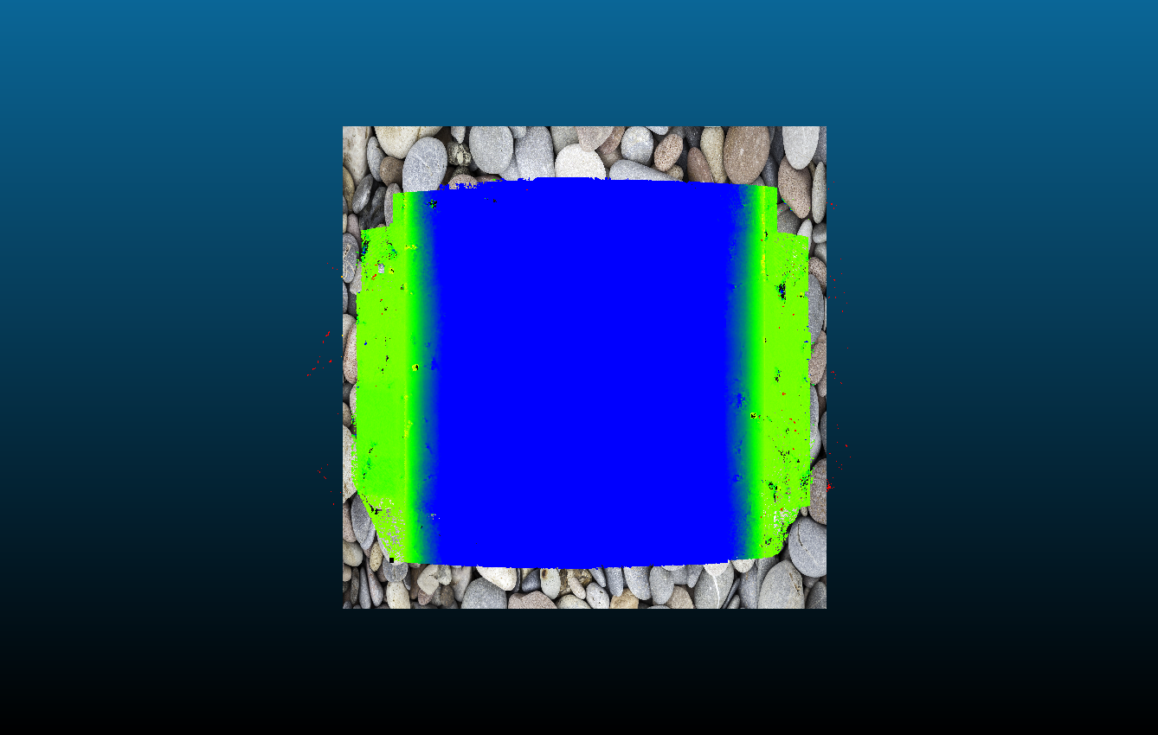
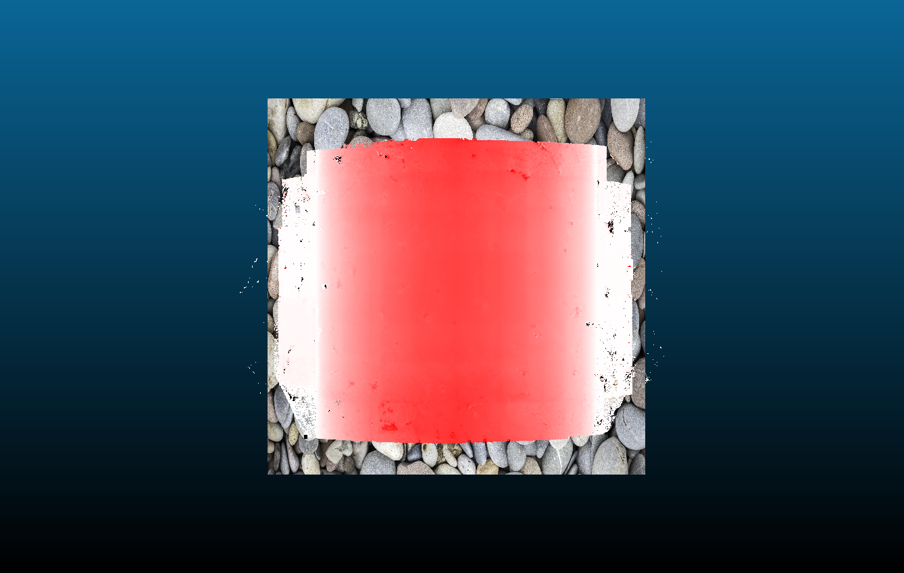
Initial “river” Observations
water
Possible to experiment with many variables and make depth correction equation?
depth_{corrected} = f(SFM calculated depth value, altitude, focal length)
Blue = water
-0.5m to 0.5m
-1.5m to 0m
1.5m too shallow

Slide 18
Paper Outline
Abstract
Intro, why relevant and novel
Background (put research in context)
Describe Computer Graphics to render a scene
How, why beneficial?
How to Validate a Computer Generated Image
Validate Object Placement (if automating placement)
Validate rotation conventions
Validate photogrammetric accuracy (fx,fy,cx,cy)
Validate Texture resolution and “sharpness”
Description workflow/methodology I developed
Proof of Concept Experiment
Hypothesis: “Do Independent GCPs bias accuracy of resultant pointcloud?”
Experiment Design/Methodology
Results
Conclusion
Conclusion/Future Work/ Implications of Methodology

Slide 19
TODO
Write!
Grow object and texture database
Develop Experiment to Test “independent GCP bias”
Write!
Make Figures
Write more

